Slide 1
IPv4 Address Classes and Masks

Slide 2
Classes of IPv4
» Classes:
• Class A: 0.0.0.0 through 127.255.255.255
• Class B: 128.0.0.0 through 191.255.255.255
• Class C: 192.0.0.0 through 223.255.255.255
• Class D: 224.0.0.0 through 239.255.255.255
• Class E: 240.0.0.0 through 255.255.255.255

Slide 3
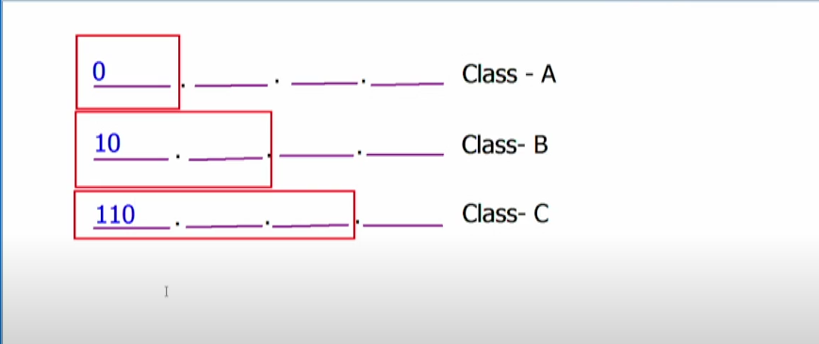
Before the subnet mask was invented
In early days we don’t need subnet mask because we were identifying the network based on the classes.

Slide 4
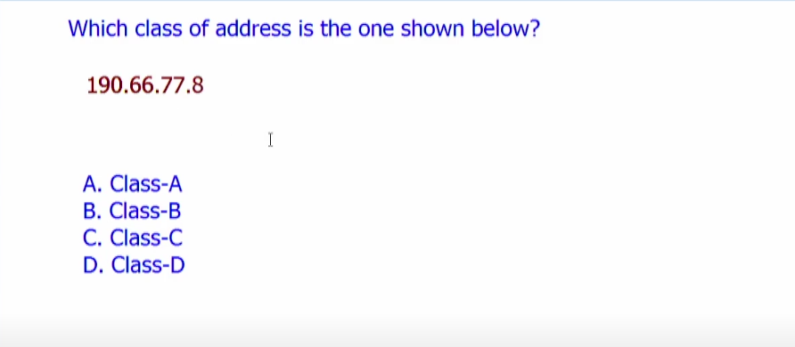
Examples

Slide 5
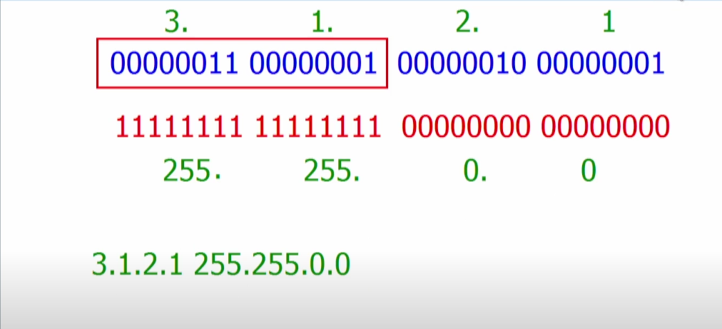
Subnet Mask
» Helps identify network and host portion of network
» Default subnet masks:
• Class A: 255.0.0.0 or /8
• Class B: 255.255.0.0 or /16
• Class C: 255.255.255.0 or /24
» Typically called classful address

Slide 6
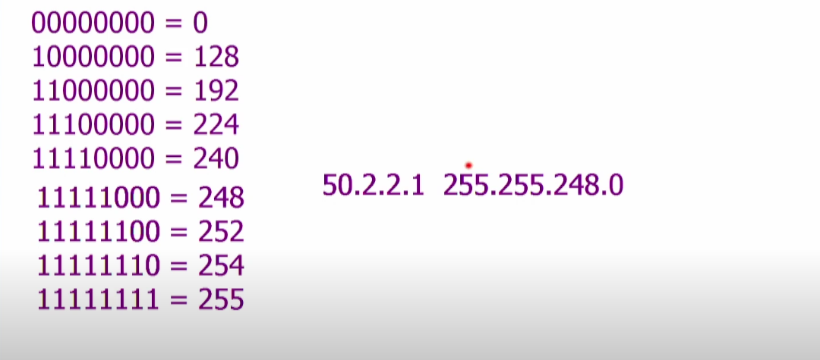
Classless Address

Slide 7
IPv4 Addresses: Public & Private
» IP addresses “leased” to a corporation are known as public IP addresses.
» IP addresses that are unregistered and may overlap from one company to the next, are known as private IP addresses

Slide 8
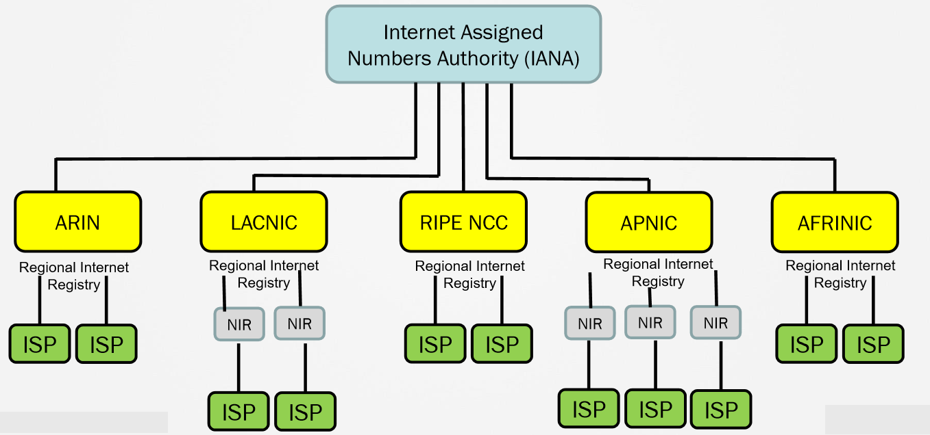
Where do Public IP Addresses Come From?

Slide 9
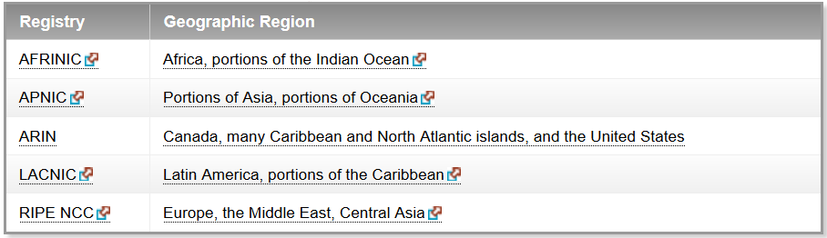
Regional internet registory

Slide 10
IPv4 Addresses: Private
» Private IPv4 address:
• Defined in RFC 1918
• For internal use only
» Range of private address
• Class A : 10.0.0.0 through 10.255.255.255
• Class B : 172.16.0.0 through 172.31.255.255
• Class C : 192.168.0.0 through 192.168.255.255

Slide 11
IPv4 Addresses: Public
» Public IPv4 addresses
• Globally unique
• Should be purchased
• Usually used in Internet edge
» Range of public addresses
• Beyond the RFC 1918 space, all addresses are public

Slide 12
IPv4 Addresses: Reserved
» Default or Unknown Address
• 0.0.0.0 » Loopback
• 127.anything
» APIPA
• 169.254.anything

Slide 13
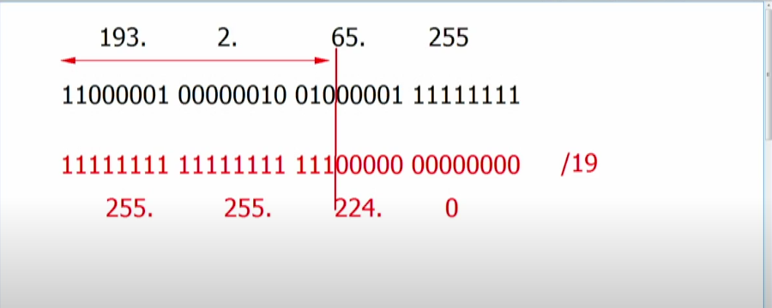
IPv4 Addressing; Configuration and Verification
Quick revision for IP and subnet mask

Slide 14
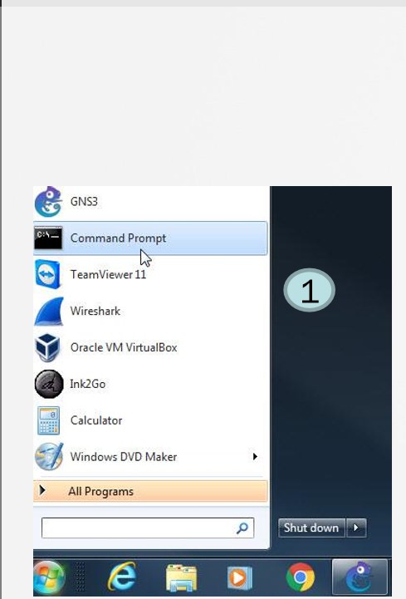
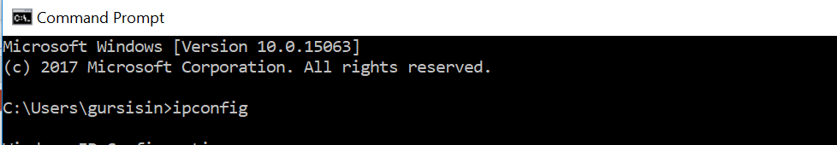
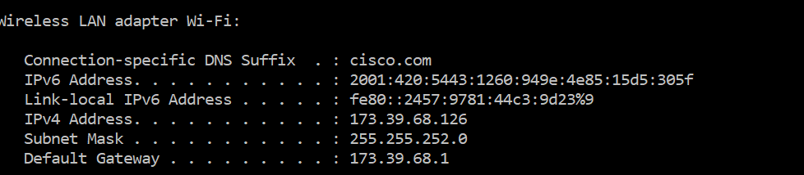
What’s my IP?

Slide 15
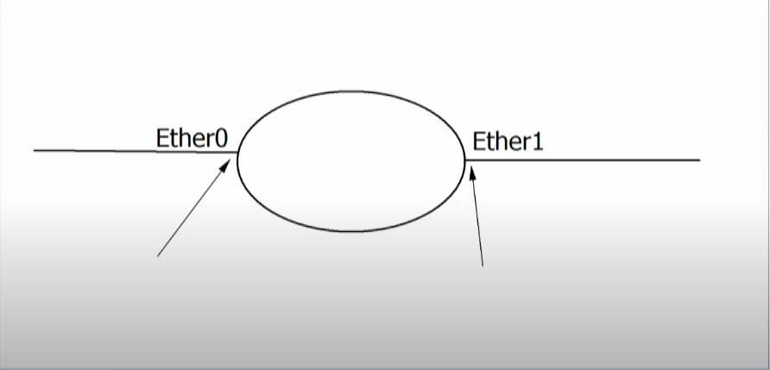
Router Interfaces

Slide 16
IP addressing – Router Configuration
» Router(config-if)# ip address <address><mask>
» Verification
• Show interface <type><number>
• Show ip interface brief

